Slide 1
ADVANCED DATA STRUCTURES
By
K. Govindaraju
Associate Professor
Dept. of Computer Science and Engineering
Aditya Engineering College(A)
Surampalem

Slide 2
  Priority Queues
A priority queue is a data structure in which each element is assigned a priority. The priority of the element will be used to determine the order in which the elements will be processed.
The general rules of processing the elements of a priority queue are
  An element with higher priority is processed before an element with a lower priority.
  Two elements with the same priority are processed on a first-come-first-served (FCFS) basis.
A priority queue can be thought of as a modified queue in which when an element has to be removed from the queue, the one with the highest-priority is retrieved first.
K. Govindaraju, Associate Professor

Slide 3
  Priority Queues
The priority of the element can be set based on various factors.
Priority queues are widely used in OS to execute the highest priority process first. The priority of the process may be set based on the CPU time it requires to get executed completely. However, CPU time is not the only factor that determines the priority, rather it is just one among several factors.
Another factor is the importance of one process over another. In case we have to run two processes at the same time, where one process is concerned with online order booking and the second with printing of stock details, then obviously the online booking is more important and must be executed first.
K. Govindaraju, Associate Professor

Slide 4
Implementation of a Priority Queue
Two ways to implement a priority queue.
  Use a sorted list to store the elements so that when an element has to be taken out, the queue will not have to be searched for the element with the highest priority
  Use an unsorted list so that insertions are always done at the end of the list. Every time when an element has to be removed from the list, the element with the highest priority will be searched and removed.
While a sorted list takes O(n) time to insert an element in the list, it takes only O(1) time to delete an element.
On the contrary, an unsorted list will take O(1) time to insert an element and O(n) time to delete an element from the list.
Practically, both these techniques are inefficient and usually a blend of these two approaches is adopted that takes roughly O(log n) time or less.
K. Govindaraju, Associate Professor

Slide 5
Representation of a Priority Queue
Linked lists
Arrays.
K. Govindaraju, Associate Professor

Slide 6
Representation of a Priority Queue using Linked list
When a priority queue is implemented using a linked list, then every node of the list will have three parts:
  (a) the information or data part,
  (b) the priority number of the element, and
  (c) the address of the next element.
If we are using a sorted linked list, then the element with the higher priority will precede the element with the lower priority.
K. Govindaraju, Associate Professor

Slide 7
Representation of a Priority Queue using Linked list
Lower priority number means higher priority.
The above priority queue is a sorted priority queue having six elements.
The element with a higher priority comes before the element with a lower priority.
From the queue, we cannot make out whether A was inserted before E or whether E joined the queue before A because the list is not sorted based on FCFS.
However, we can say that C was inserted before D(same priority elements are arranged on FCFS principle.)
K. Govindaraju, Associate Professor

Slide 8
Insertion Operation
When a new element has to be inserted in a priority queue, we have to traverse the entire list until we find a node that has a priority lower than that of the new element. The new node is inserted before the node with the lower priority.
However, if there exists an element that has the same priority as the new element, the new element is inserted after that element.
Example: Consider the priority queue
Insert a new element with data = F and priority number = 4, then the element will be inserted before D that has priority number 5, which is lower priority than that of the new element.
K. Govindaraju, Associate Professor

Slide 9
Deletion Operation
Deletion is simple as the first node of the list will be deleted and the data of that node will be processed first.
From the priority queue given, perform delete.
As delete operation removes the first element of the list, the priority queue is
K. Govindaraju, Associate Professor

Slide 10
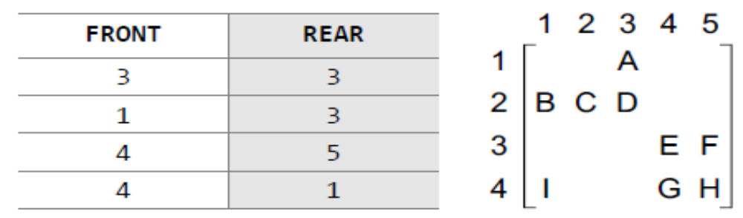
Array representation of a Priority Queue
A separate queue for each priority number is to be maintained.
Each of these queues will be implemented using circular arrays or circular queues.
Every individual queue will have its own FRONT and REAR pointers.
We use a two-dimensional array for this purpose where each queue will be allocated the same amount of space.
K. Govindaraju, Associate Professor

Slide 11
Given the FRONT and REAR values of each queue, the two-dimensional matrix can be formed.
FRONT[K] and REAR[K] contain the front and rear values of row K, where K is the priority number.
Note that here we are assuming that the row and column indices start from 1, not 0.
K. Govindaraju, Associate Professor

Slide 12
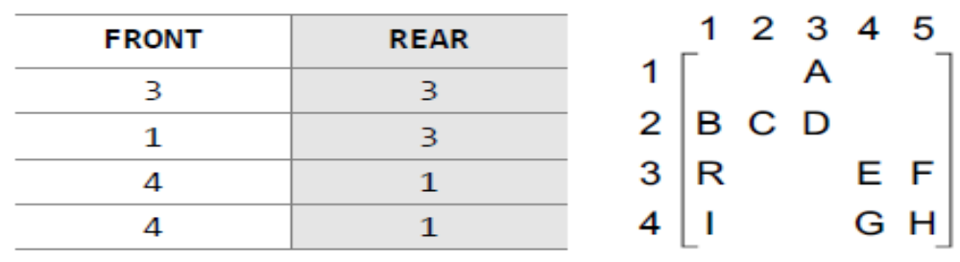
Insertion Operation
To insert a new element with priority K in the priority queue, add the element at the rear end of row K, where K is the row number as well as the priority number of that element.
Example: Insert an element R with priority number 3.
The priority queue will be
K. Govindaraju, Associate Professor

Slide 13
Deletion Operation
To delete an element, find the first non-empty queue and then process the front element of the first non-empty queue.
In our priority queue, the first non-empty queue is the one with priority number 1 and the front element is A, so A will be deleted and processed first.
After deletion, the priority queue will be
0
0
K. Govindaraju, Associate Professor

Slide 14
In a priority queue the logical order of elements is determined by their priority.
While the higher priority elements are added at the front of the queue, elements with lower priority are added at the rear.
Implementing priority queues using a linear array, requires O(n) time to insert an element and at least O(n log n) time to sort the array.
A better way to implement a priority queue is by using a binary heap which allows both enqueue(insertion) and dequeue(deletion) of elements in O(log n) time.
K. Govindaraju, Associate Professor

Slide 15
Binary Heaps
A binary heap is a complete binary tree in which every node satisfies the heap property which states that
If B is a child of A, then key(A) ≥ key(B).
The root node has the highest key value in the heap. Such a heap is commonly known as a max-heap. (Alternatively, if the root has the lowest key value, then the resultant heap is called a min-heap.)
K. Govindaraju, Associate Professor

Slide 16
Binary Heaps
A binary heap has 2 properties.
1) Structure Property 2) Heap order Property
Structure Property:
A heap is a binary tree that is completely filled, with the possible exception of the bottom level , which is filled from left to right. Such a tree is a complete binary tree.
The properties of binary heaps are given as follows.
Since a heap is defined as a complete binary tree, all its elements can be stored sequentially in an array. It follows the same rules of complete binary tree. That is, an element at position i in the array, has its left child stored at position 2i and its right child at position 2i + 1. Conversely, an element at position i have its parent stored at position i/2.
Being a complete binary tree, all levels of the tree except the last level are completely filled.
Height of a binary tree is given as log₂ n, where n is the number of elements.
Heaps are a very popular data structure for implementing priority queues.
K. Govindaraju, Associate Professor

Slide 17
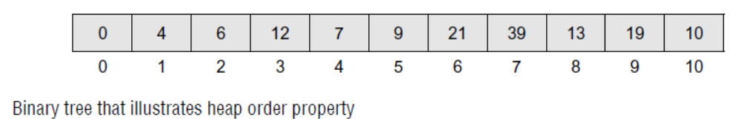
Binary Heaps
Heap order Property
The heap order property states that for every node x with parent p, the key in p is smaller than or equal to the key in x (min heap).
4
99
Min heap
Max heap
6
12
63
72
7
45
9
21
39
69
21
39
13
19
10
27
36
54
K. Govindaraju, Associate Professor

Slide 18
Binary Heaps
Basic Heap Operations for MaxHeap
Insert
DeleteMax
Other MaxHeap Operations
getMax - returns the root element of max heap
extractMax – removes the max element of max heap
Delete(P,H)- removes the node at position P from the heap H
increaseKey(P, x, H)- increases the value of key at position P by a value x in Max Heap H.
decreaseKey(P, x, H)- decreases the value of key at position P by a value x in Max Heap H.
buildHeap(H)- takes n keys and places them into an empty heap H.
NOTE: Conversely, insert, deleteMin, getMin,extractMin, delete, increaseKey, decreaseKey, buildHeap are used for Min Heap.
K. Govindaraju, Associate Professor

Slide 19
Insertion into a Binary Heaps
Consider a max heap H having n elements. Inserting a new value into the heap is done in two major steps.
Step 1: Add the new value at the bottom of H in such a way that H is still a
complete binary tree but not necessarily a heap.
Step 2: Let the new value rise to its appropriate place in H(perculate up) so that
H now becomes a heap as well.
To do this, compare the new value with its parent; to check if they are in the correct order. If they are in the correct order, then the procedure halts else, the new value and its parent’s value is swapped and step 2 is repeated.
K. Govindaraju, Associate Professor

Slide 20
Insertion into a Binary Heaps
Consider the heap given below and insert 99 in it
54
54
45
36
45
36
27
21
18
21
27
21
18
21
11
11
99
54
45
36
99
21
18
21
11
27
K. Govindaraju, Associate Professor

Slide 21
Insertion into a Binary Heaps
99
54
54
36
99
36
45
21
18
21
45
21
18
21
11
27
11
27
K. Govindaraju, Associate Professor

Slide 22
Insertion into a Binary MaxHeap
Algorithm to insert a value in Max heap
Step 1: [Add the new value and set its POS]
SET N = N + 1, POS = N
Step 2: SET HEAP[N] = VAL
Step 3: [Find appropriate location of VAL]
Repeat Steps 4 and 5 while POS > 1
Step 4: SET PAR = POS/2
Step 5: IF HEAP[POS] <= HEAP[PAR], then
Goto Step 6.
ELSE
SWAP HEAP[POS], HEAP[PAR]
POS = PAR
[END OF IF]
[END OF LOOP]
Step 6: Return
K. Govindaraju, Associate Professor

Slide 23
Insertion into a Binary MinHeap
Algorithm to insert a value in Min heap
Step 1: [Add the new value and set its POS]
SET N = N + 1, POS = N
Step 2: SET HEAP[N] = VAL
Step 3: [Find appropriate location of VAL]
Repeat Steps 4 and 5 while POS > 1
Step 4: SET PAR = POS/2
Step 5: IF HEAP[POS] >= HEAP[PAR], then
Goto Step 6.
ELSE
SWAP HEAP[POS], HEAP[PAR]
POS = PAR
[END OF IF]
[END OF LOOP]
Step 6: Return
K. Govindaraju, Associate Professor

Slide 24
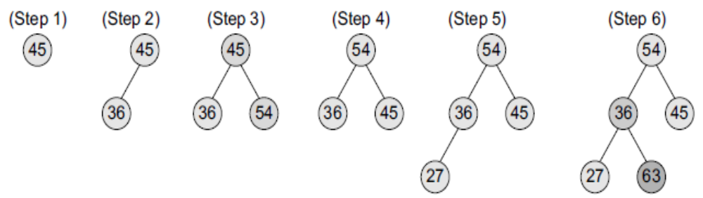
Example: Build a max heap H from the given set of numbers: 45, 36, 54, 27, 63, 72, 61, and 18. Also draw the memory representation of the heap.
Solution:
K. Govindaraju, Associate Professor

Slide 25
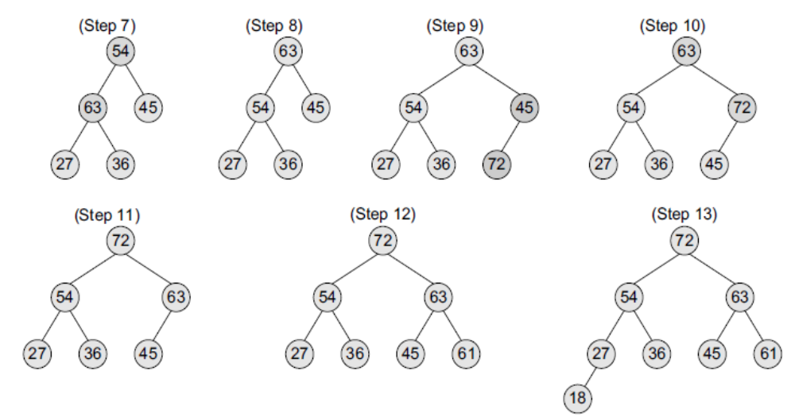
K. Govindaraju, Associate Professor

Slide 26
The memory representation of H can be given as
The complexity of this algorithm in the average case is O(1). This is because a binary heap has O(log n) height.
Since approximately 50% of the elements are leaves and 75% are in the bottom two levels, the new element to be inserted will only move a few levels upwards to maintain the heap.
In the worst case, insertion of a single value may take O(log n) time and, similarly, to build a heap of n elements, the algorithm will execute in
O(n log n) time.
K. Govindaraju, Associate Professor

Slide 27
Delete Max from Max Heap
Consider a max heap H having n elements. An element is always deleted from the root of the heap. So, deleteMax is deleting an element from the heap, which is done in three major steps.
Replace the root’s node value with the last node’s value so that H is still a complete binary tree but not necessarily a heap.
Delete the last node.
Sink down(Perculate down) the new root node’s value so that H satisfies the heap property. In this step, interchange the root node’s value with its child node’s value (whichever is largest among its children).
K. Govindaraju, Associate Professor

Slide 28
Delete Max from MaxHeap
Consider the max heap H given below and delete the root node’s value.
54
45
36
27
29
18
21
11
11
11
45
36
45
36
27
29
18
21
27
29
18
21
45
45
11
36
29
36
27
29
18
21
27
11
18
21
K. Govindaraju, Associate Professor

Slide 29
ALGORITHM TO DELETE AN ELEMENT FROM MAX HEAP
DELETE_MAXHEAP(HEAP, N, VAL)
Step 1: [ Remove the last node from the heap]
SET LAST = HEAP[N], SET N = N – 1
Step 2: [Initialization]
SET PRT = 1, LEFT = 2, RIGHT = 3
Step 3: SET HEAP[PRT] = LAST
Step 4: Repeat Steps 5 to 7
while LEFT <= N
Step 5: IF HEAP[PRT] >= HEAP[LEFT] AND HEAP[PRT] >= HEAP[RIGHT], then
Go to Step 8
[END OF IF]
Step 6: IF HEAP[RIGHT] <= HEAP[LEFT], then
SWAP HEAP[PRT], HEAP[LEFT]
SET PRT = LEFT
ELSE
  SWAP HEAP[PRT], HEAP[RIGHT]
SET PRT = RIGHT
[END OF IF]
Step 7: SET LEFT = 2 * PRT and RIGHT = LEFT + 1
[END OF LOOP]
Step 8: Return
54
45
36
27
29
18
21
11
K. Govindaraju, Associate Professor

Slide 30
ALGORITHM TO DELETE AN ELEMENT FROM MIN HEAP
DELETE_MINHEAP(HEAP, N, VAL)
Step 1: [ Remove the last node from the heap]
SET LAST = HEAP[N], SET N = N – 1
Step 2: [Initialization]
SET PRT = 1, LEFT = 2, RIGHT = 3
Step 3: SET HEAP[PRT] = LAST
Step 4: Repeat Steps 5 to 7
while LEFT <= N
Step 5: IF HEAP{PRT] <= HEAP[LEFT] AND HEAP[PRT] <= HEAP[RIGHT], then
Go to Step 8
[END OF IF]
Step 6: IF HEAP[RIGHT] >= HEAP[LEFT],
then
SWAP HEAP[PRT], HEAP[LEFT]
SET PRT = LEFT
ELSE
  SWAP HEAP[PRT], HEAP[RIGHT]
SET PRT = RIGHT
[END OF IF]
Step 7: SET LEFT = 2 * PRT and RIGHT = LEFT + 1
[END OF LOOP]
Step 8: Return
K. Govindaraju, Associate Professor

Slide 31
Applications of Priority Queues
Some of the applications of Prority Queues are given below.
Dijkstra’s Shortest Path Algorithm
In Prim’s algorithm to store keys of nodes and extract minimum key node at every step.
In Huffman codes for data compression.
In OS for process management and sharing limited computer resources with multiple processes. The priority queue is used to arrange all processes according to their priority so that the highest priority process is serviced before others.
Efficiently sorting numbers (heap sort).
Scheduling events. For example, to simulate traffic light as in when a light changes to red, the next change is scheduled to green after n seconds.
K. Govindaraju, Associate Professor

Slide 32
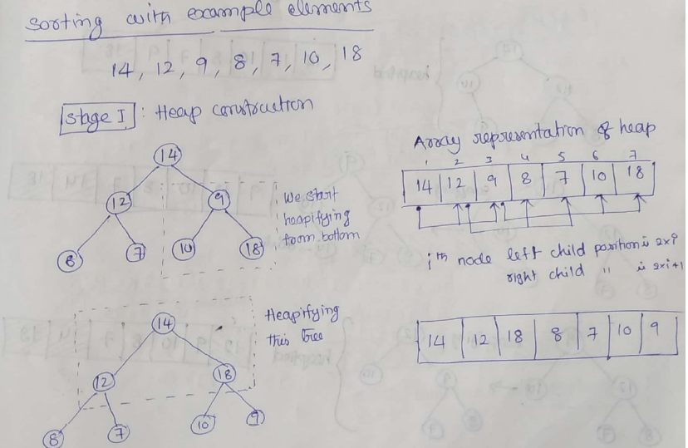
  Heap Sort
K. Govindaraju, Associate Professor

Slide 33
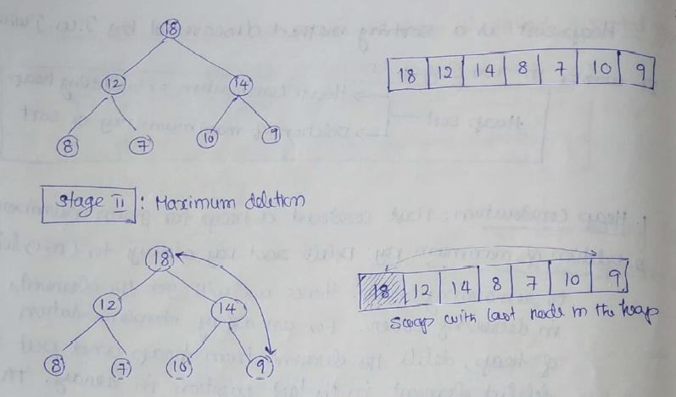
  Heap Sort
K. Govindaraju, Associate Professor

Slide 34
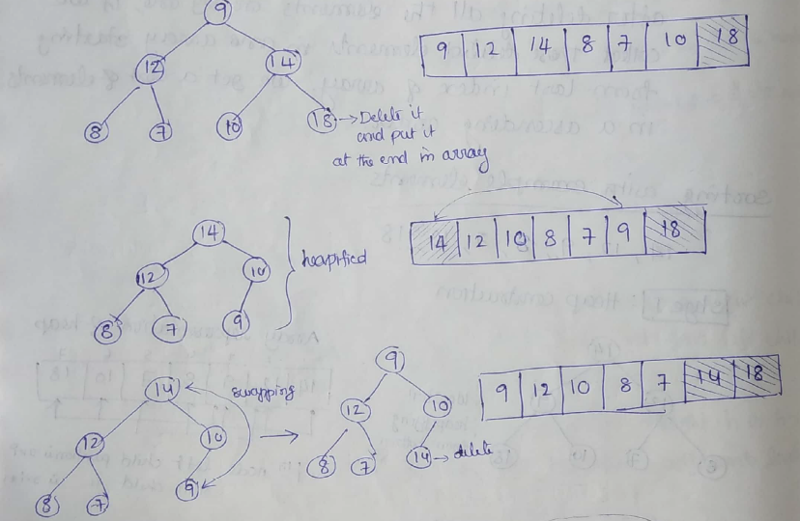
  Heap Sort
K. Govindaraju, Associate Professor

Slide 35
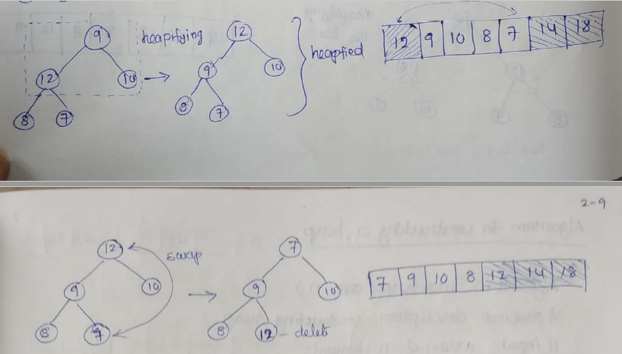
  Heap Sort
K. Govindaraju, Associate Professor

Slide 36
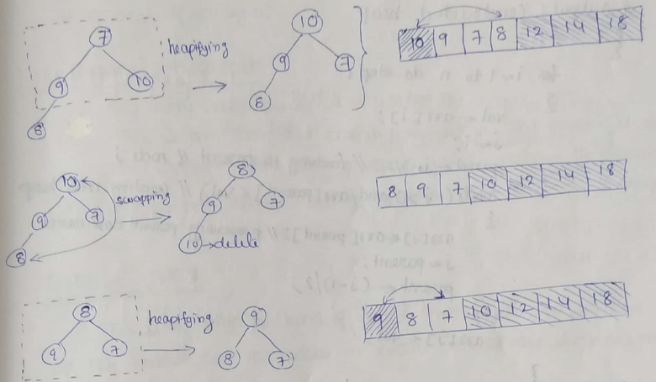
  Heap Sort
K. Govindaraju, Associate Professor

Slide 37
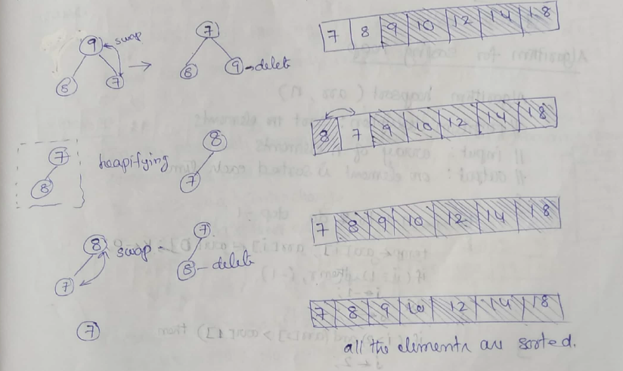
  Heap Sort
K. Govindaraju, Associate Professor

Slide 38
  Sort the given string in alphabetical order
  “COMPUTER”
K. Govindaraju, Associate Professor

Slide 39
K. Govindaraju, Associate Professor

Slide 40
K. Govindaraju, Associate Professor

Slide 41
  Any Queries?
K. Govindaraju, Associate Professor

Slide 42
  Thank You
K. Govindaraju, Associate Professor

